Slide 1
The effect of tangible artifacts, gender and subjective technical competence on teaching programming to 7th graders
Philipp Brauner
Thiemo Leonhardt
Martina Ziefle
Ulrik Schroeder

Slide 2
Outline
Motivation
Experimental Setup
Results
Discussion
Q & A

Slide 3
Motivation
High demand for STEM professionals
Gender inequality in STEM
Several different concepts to teach programming. What works best?
Programmable robots used as motivation (schools & universities)

Slide 4
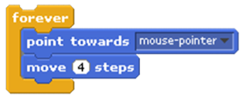
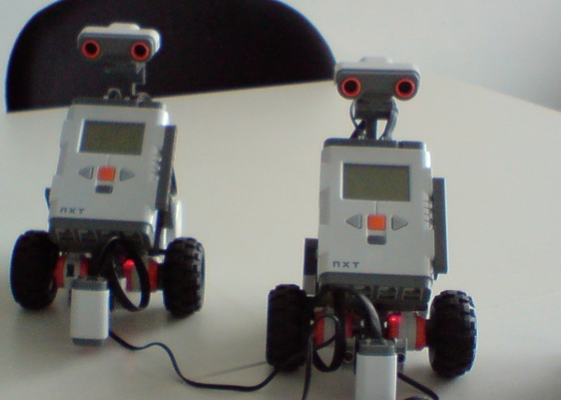
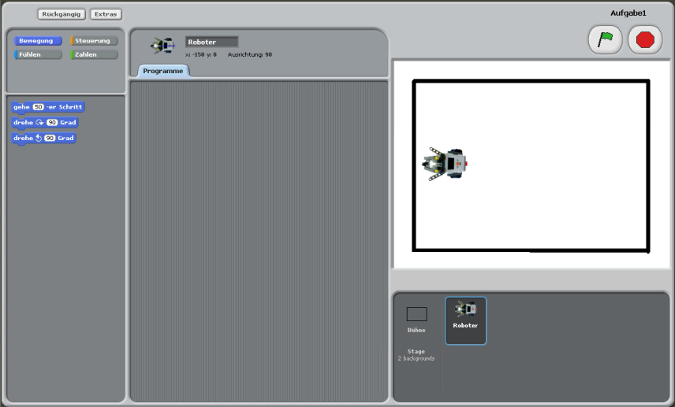
Experimental Setup 1/2
2 Conditions: Visual Turtle and Tangible Turtle
Modified version of Scratch
Reduced UI
31 participants, 13-14 years old
Specialization courses, STEM support projects (go4IT!, Roberta)
 | tangible | visual | ∑
Male | 8 | 8 | 16
Female | 6 | 9 | 15
∑ | 14 | 17 | 31

Slide 5
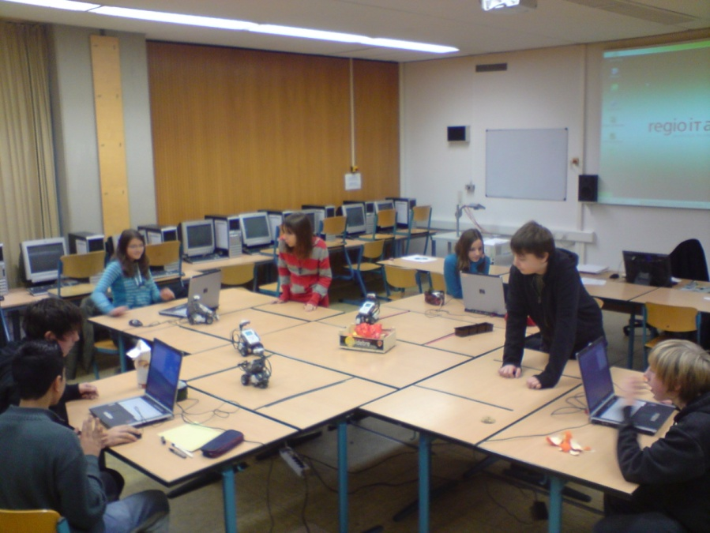
Experimental Setup 2/2
4 groups with 4 student-pairs each (mixed gender)
Separate and shared spaces
Black lines for light sensors
Adequate addressing

Slide 6
Teaching unit
Aspect | Time (∑=90min)
Introduction, 1st questionnaire | 15 min.
Task 1: simple movements, no conditions/loops | 20 min.
Task 2: simple movements w. loops | 20 min.
2nd questionnaire | 15 min.
Task 3: sensor-driven movements | 20 min.
Task 3 after last questionnaire => Effect not evaluated!
Informal Observations:
Not concentrated in the afternoon lesson
Remote controlling

Slide 7
Variables
Controlled experiment: I₁×…×I_{m} → D₁×…×D_{n}
IV: Gender, Modality
DV_{before}: Weekly Computer Usage, Subjective competencies (Technical, Math, Computer)
DV_{after}: Perceived simplicity, Interest in course, Interest in STEM, Learning Outcome (reading/writing)
Notes:
Comp. Programming self-efficacy raus?
Factors with multiple items each.

Slide 8
Subjective Technical Competence (STC)
8 item scale
„Usually, I successfully cope with technical problems“
Similar to Bandura’s self-efficacy
Group differences statistically controlled
Notes:
Beier, Cronbach‘s alpha=.89

Slide 9
Outline
Motivation
Experimental Setup
Results
Factor: Display Modality
Factor: Gender
Factor: Subjective Technical Competence
Discussion
Q & A (feel free to interrupt us)

Slide 10
Factor: Display Modality
Reading a program (no difference)
Writing a program (mild advantage)
Screen: | Ø 3,1 Points
Turtle: | Ø 3,1 Points
Screen: | Ø 3,7 Points
Turtle: | Ø 4,4 Points
Notes:
Kein Unterschied beim Lesen eines Programms
Beim Schreiben ist die Turtle-Gruppe besser (fast signifikant, p=.052, sig. bei 10%)

Slide 11
Factor: Display Modality
Learning outcome
= Reading a program: No differences (3.1 vs. 3.1 Pts)
+ Writing a program: small advantage (4.4 vs. 3.7 Pts)
Course feedback
= no increased interested in course
+ increased interest in programming and technology (but stat. not sig.)
Notes:
Increased STEM interest (75 vs. 88 Points) but stat. not significant. Esp. Visual Group extremly noisy (SD=23 vs. SD=9)
STEM-Scale four items:
Neugierig auf‘s Programmieren: 71 zu 88
Häufiger Programmieren: 64 zu 81
Mehr Technik: 78 zu 92.
=> Other factors?!

Slide 12
Factor: Gender
 | Correlations:
Boys: | Mathematics and Calculating Geometry and Computers Calculating and Computers | r=.568 r=.101 r=.219
Girls: | Mathematics and Calculating Geometry and Computers Calculating and Computers | r=.010 r=.414 r=.571
Girls see Calculating and
computers as connected

Slide 13
Factor: Gender
Reading a program (no differences)
Writing a program (Boys sig. Better)
Boys: | Ø 3.0 Points
Girls: | Ø 3.2 Points
Boys: | Ø 4,3 Points
Girls: | Ø 3,6 Points

Slide 14
Factor: Gender: Boys ≠ Girls
Learning outcome
No differences for reading a program (3.0 vs. 3.2 Pts)
Boys better at writing a program (4.3 vs. 3.6 Pts)
Weekly Computer usage (12.8h vs. 8.4h)
Subj. Tech. Competence (73 Pts. vs. 55 Pts)
Course Feedback
Boys (believe to) understand better
No difference for interest in STEM (!)

Slide 15
Factor: STC (sub. tech. competence)
 | STC
 | Low | High | Σ
Boys | 3 | 13 | 16
Girls | 13 | 2 | 15
Σ | 16 | 15 | 31
Median split (x̃=64)
Increased weekly computer usage (12.6h vs. 8.9h) and perceived computer competency
Course interest: No difference
STC high → higher interest in STEM
Increased learning outcome (reading & writing)

Slide 16
Factor STC: Learning Outcome
Reading a program^{(*)}
Writing a program*
Low STC: | Ø 2.8 Points
High STC: | Ø 3.4 Points
Low STC: | Ø 3.4 Points
High STC: | Ø 4.5 Points

Slide 17
Conclusions 1/2
Tangible Turtle: Mild advantages
Writing a program
Probably STEM interest
Girls performed lower than boys:
Lower computer usage
Writing a program
Lower STC
BUT: Same interest in STEM (if STC is controlled)

Slide 18
Conclusions 2/2
STC (subjective technological competence) important factor
better performance
computer usage and sub. computer competence
higher interest in STEM
Huge gender difference at the age of 13/14
When does it split?
What can we do about this?
Notes:
Wann geht das los?
Was kann man dagegen machen?

Slide 19
Limitations & Outlook
Limitations:
Small n (n=31; 16 male, 15 female)
Artificial group sizes (e.g. 8 instead of 30 students)
No STC balancing possible
Mostly subjective data
Outlook:
Start earlier (e.g. Electronic Blocks)
More positive experience
More female role models

Slide 20
Take away / Summary
Turtle mild advantages
Writing programs
STEM interest?
Girls showed lower performance
Probably caused by lower STC
(Always be careful what‘s causing the effect!)
Serve STC differences at age 13 => counter-measures need to start much earlier
Subjective competencies important mediator for success
Thank you very much!

Slide 21
BONUS SLIDES

Slide 22
Programming Self-Efficacy Scale
Correlated with STC
Cronbach‘s α = .615
„detects“ display modality and gender
BUT: differences fade in arithmetic mean
=> Important tool for assessing student‘s competencies
Needs to be reworked

Slide 23
MONOVA with covariates
Experiment:
I₁ × … × I_{m} → D₁ × … × D_{n}
MANOVA (Multivariate Analyses of variance):
Effect of all I_{i} on all D_{j}
But: real-life is usually noisy:
I₁ × … × I_{m} × N₁ … × N_{o} → D₁ × … × D_{n}
This noise can be statistically controlled (analyses of covariance)

Slide 24
Self-Efficacy (Bandura)
“Belief that one is capable of performing in a certain manner to attain certain goals”
Context-specific (≠ self-confidence)
Important mediator for career choices
Experience
Choice
Self-Efficacy
(Bandura)
Modeling (Vicarious experience)
Performance
Social persuasions
Physiological factors
Persistence

Slide 25
Why Scratch?
Programming with visual blocks
„Web 2.0“ of the programming languages (Share, Remix)
Gender-equal participation in Scratch‘s online-community
Modified for experiment: Gateway to robot, simplified UI

