Slide 1
Showing Core-Concepts of Informatics to Kids an their Teachers
Roland Mittermeir
Ernestine Bischof
Karin Hodnigg
Institut für Informatik-Systeme
Universität Klagenfurt
Universitätsstraße 65-67
A-9020 Klagenfurt

Slide 2
Initial situation
Informatics education in the Austrian curriculum since 1984
Focus on programming and algorithmic concepts
Overall educational value of CS rarely discussed
Most teachers have their key qualifications in other domains
Now: educational goal → Computer literacy

Slide 3
Motivation
Status:
  Computer science education – use of applications
  Curricula left on a general level
  Application-related concepts easier to teach
  Difficult to „re-educate“ teachers
  ECDL oriented lessons
Aim:
  Show core principles of informatics to pupils
  AND to teachers

Slide 4
A look at 9th grade CS-lessons
ECDL curriculum fills the informatics lessons
Pupils associate informatics with „Word“, „text processing“, „Excel“, „boring“, „presentations“
Distorted image of informatics as scientific discipline

Slide 5
Where to start from?
Project Informatik erLeben
Set of interventions
Units for pupils from primary school up to secondary school
Booklet and website with material for teachers
Teachers observe and copy the units
Teachers are becoming multiplier for our idea

Slide 6
Aims
Showing teachers that informatics is not all that difficult (to teach and to grasp)
Showing teachers that pupils are not basically technology-averse
Showing pupils, that informatics has to do much more with humans than with the machine

Slide 7
Principles of our concept
Challenging the curiosity of the children
Getting part of the underlying concept
Active participation in games, animations, simulations
Encourage active observation

Slide 8
Description of some units
Image processing
  Additive, subtractive color
  Raster vs. Vector graphics
  Color depth

Slide 9
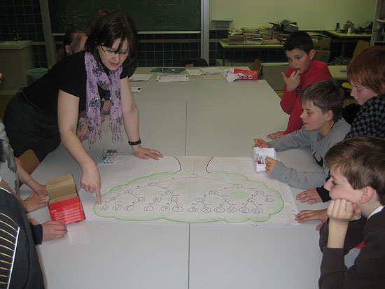
Description of some units
Coding
  Morsegame
  Creating codes with colors
  Code trees
  Code optimazition

Slide 10
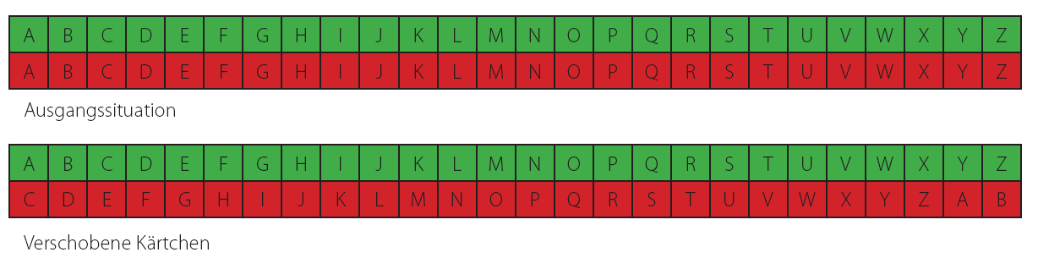
Description of some units
Encryption
  Caesar cyphers
  Vigenerè cyphers
  Public key encryption

Slide 11
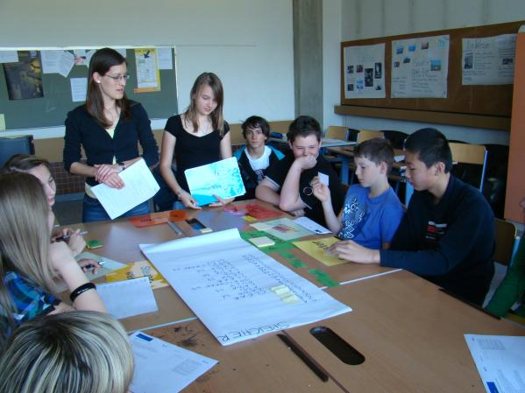
Description of some units
Hardware
  Dis- and reassembling PCs
  Simulation of the operations within the PC

Slide 12
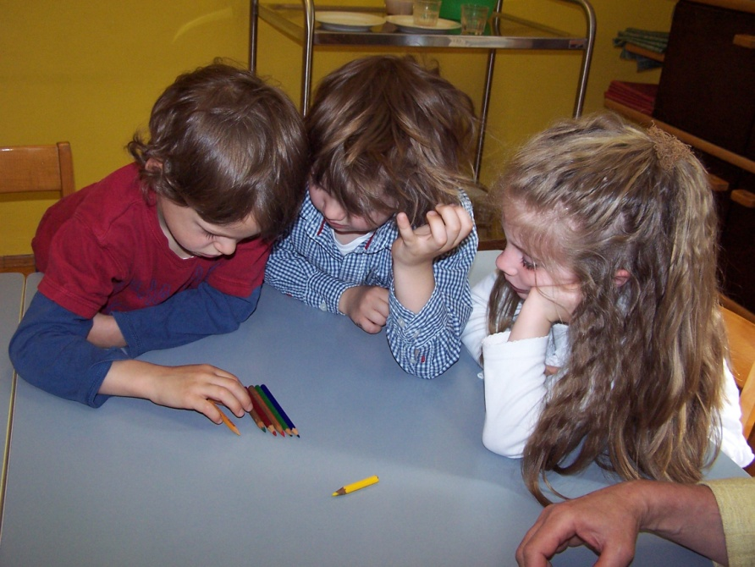
Description of some units
Algorithms, Searching, Sorting
  Written esay for giving directions
  Simulation for some Searching und Sorting Algorithms

Slide 13
Description of some units
Operating systems and computer networks
  Pharmacy game
  Deadlocks, Lifelocks,
  Routing Algorithms
  Protocols

Slide 14
Intermediate Evaluation
Questionnaire with two questions to be answered in free text
Observation of the pupil’s attention
Review session with teachers and pupils
Creation of questions to the topic by the children.

Slide 15
Questionnaire
What does informatics mean for you?
Playing computer games | 20 | Decompose computers | 12
Surfing the internet | 17 | Games | 9
Downloading films | 11 | Codes/coding | 7
E-Mail | 10 | Morse-alphabet | 7
Watching and processing pictures | 10 | Internet | 6

Slide 16
Observation by the teachers
Primary School
 | Lecture (n=64) | Animation (n=62) | Individual work (n=51) | Group/pair Work (n=62)
On-task passive | 1 | 7 | 0 | 0
On-task active | 58 | 52 | 51 | 61
On-task reactive | 25 | 0 | 22 | 24
Off-task passive | 0 | 3 | 0 | 0
Off-task disturbing | 2 | 0 | 0 | 1

Slide 17
Observation by the teachers
Lower secondary schools
 | Lecture (n=54) | Animation (n=50) | Individual work (n=48) | Group/Pair work (n=13)
On-task passive | 24 | 22 | 10 | 0
On-task active | 30 | 26 | 38 | 13
On-task reactive | 0 | 1 | 0 | 0
Off-task passive | 0 | 1 | 0 | 0
Off-task disturbing | 0 | 0 | 0 | 0

Slide 18
Observation by the teachers
Upper secondary schools
 | Lecture (n=26) | Animation (n=15) | Individual work (n=6) | Group/pair work (n=18)
On-task passive | 11 | 8 | 2 | 5
On-task active | 6 | 5 | 6 | 13
On-task reactive | 3 | 2 | 0 | 0
Off-task passive | 4 | 0 | 0 | 0
Off-task disturbing | 2 | 0 | 0 | 0

Slide 19
Review session with teachers and pupils
Some teachers successfully transferred the approach to another class.
Teachers and pupils would like to have more Informatik erLeben lessons.
Only one teacher gave a clearly negative feedback.
Some teachers made follow up lessons with their classes.
The lecture part should not become too long.

Slide 20
Conclusions
Success is easier reached with primary school kids (and teachers).
Secondary school teachers already tried our approach on their own.
One teacher even developed an extension
to a unit.
Interest and awareness have been created.

Slide 21
Thank you for your attention!
Questions, comments?
Online material:
http://informatik-erleben.uni-klu.ac.at

